Slide 1
Culture and Communication
Bhagya Hapuarachchi
National Institute of Business Management

Slide 2
Aims for Today’s Session
To discuss how culture and communication are interconnected
To discuss how personality and communication are interconnected

Slide 3
Content
What is culture
Culture and communication
Intercultural competence
Human Mental Programming
What is personality
MBTI

Slide 4
What is Culture?
The way of life of people passed down from one generation to the next through learning.
Examples of culture include language, technology, economic, political and educational systems, religious and aesthetic patterns, and social structures (Trandis 1990).

Slide 5
Culture and Communication
Culture is an important part of the expression and communication of human feelings (Brislin 1993).
Culture impacts on many aspects of human behaviour: intercultural communication is one.
Intercultural communication can be simply called the communication between people from different cultures (Gudykunst and Mody 2002).

Slide 6
Culture and Communication
There can be differences in intercultural communication as a result of some stereotypes and constraints in cultural beliefs and norms.
These differences are manifested in verbal and non-verbal communication methods.

Slide 7
Intercultural Competence
Intercultural competence is the capacity to change one’s knowledge, attitudes, and behaviors so as to be open and flexible to other cultures.
Taylor (1994) defines intercultural competency as a transformative process whereby the stranger develops adaptive capacity, altering his/her perspective to effectively understand and accommodate the demands of the host culture.

Slide 8
Intercultural Competence: Components
Intercultural Sensitivity
Intercultural sensitivity represents both the ability of an individual to distinguish between the different behaviors, perceptions, and feelings of a culturally different counterpart and the ability to appreciate and respect them.
Intercultural sensitivity consists of three elements, including the understanding of cultural behaviors, open-mindedness towards cultural differences, and behavioral flexibility in host culture (Bhawuk and Brislin 1992).

Slide 9
Intercultural Competence: Components
It is thought that people with higher intercultural sensitivity will become more confident global citizens as their understanding of cultural difference becomes more sophisticated.

Slide 10
Why is Cultural Sensitivity Necessary?
Most businesses work with people from two or more different cultural backgrounds .
It is important to promote effective communication among employees and employers.

Slide 11
Why is Cultural Sensitivity Necessary?
Communication may have many implications and potential barriers, as it includes both verbal (language) and non-verbal (gestures, personal space, etc.) methods of expressing meaning or emotion.

Slide 12
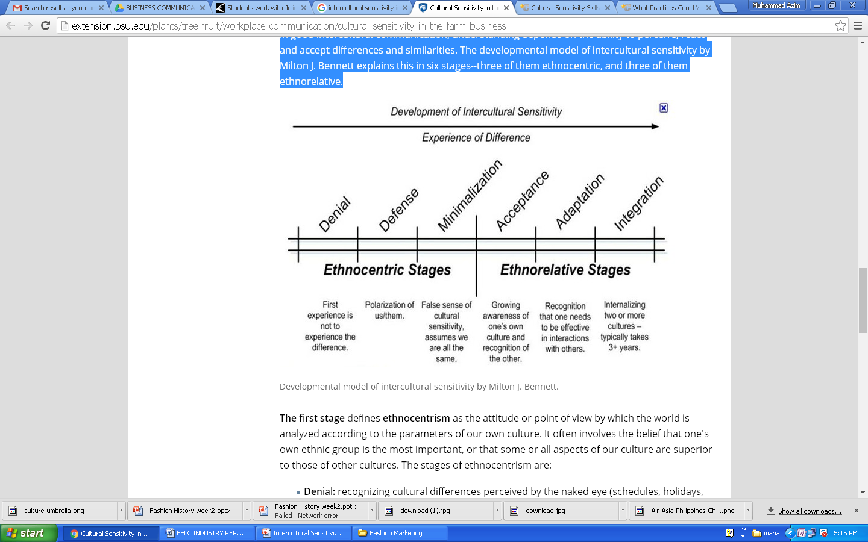
Intercultural Sensitivity by Milton J. Bennett

Slide 13
Ethnocentrism Stage
The first stage defines ethnocentrism describes the point of view that the world is seen according to our own culture.
It often involves the belief that a persons own ethnic group is the most important, or that some or all aspects of our culture are superior to those of other cultures.
The stages of ethnocentrism are:
Denial: recognizing cultural differences seen by the naked eye (color, religion, holidays, food, dress , etc.) but denying deeper differences.
Defense: criticizing other cultures with negative terms as a result of feeling threatened, which leads to negative stereotypes, prejudices and discriminatory attitudes.
Minimization: thinking that values and behavior are universal principles and are equal to their own.

Slide 14
Ethno-relativism Stage
The second stage is ethno-relativism, it is a learned skill, where a person consciously recognizes values and behaviors as a cultural matter rather than a universal one.
The stages of ethno-relativism are:
Acceptance: recognizing that cultural differences must be respected in order to improve interactions. We may not agree with a specific cultural practice or difference but we respect a co-worker’s values.
Adaptation: to be able to change a cultural outlook or behavior, which improves understanding and communication in different cultural contexts.
Integration: an effort to combine or involve different cultural elements and feel comfortable with multi-cultural situations.
The concept of developing intercultural sensitivity shows that our perception is flexible, and we all have the ability to alter our sensitivity according to new experiences.

Slide 15
Intercultural Competence: Components
Intercultural Awareness
Intercultural awareness represents the cognitive process a person goes through in his or her own and others’ cultures.

Slide 16
Intercultural Competence: Components
Intercultural Effectiveness
Intercultural effectiveness deals with the ability to attain communication goals in intercultural interactions.

Slide 17
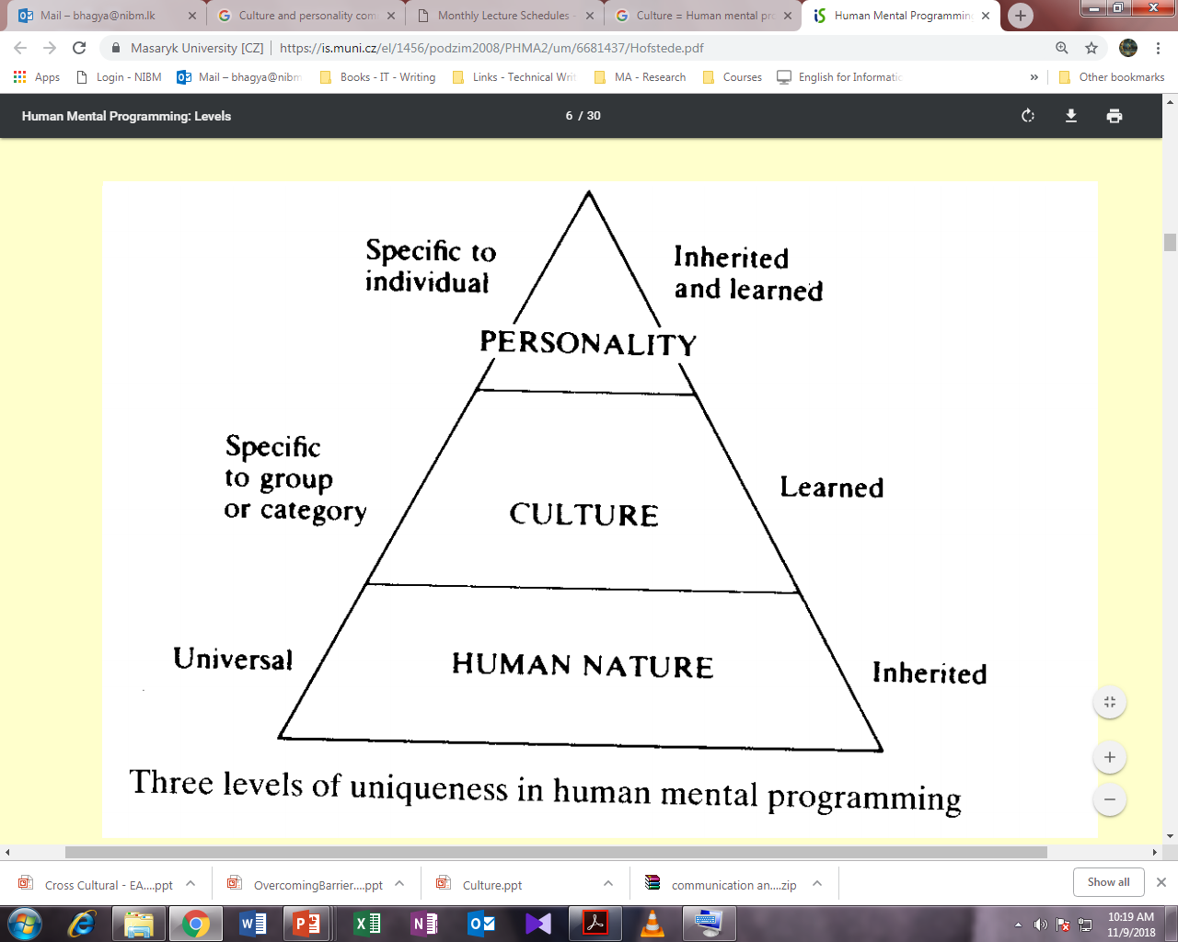

Slide 18
Human Mental Programming
Culture is the collective programming of the mind that separates one group of people from another (Hofstede 2005).
The mental programming model presented by Hofstede illustrates the relationship of culture with personality and human nature.
This programming influences patterns of thinking which are reflected in the meaning people attach to various aspects of life and which become crystallized in the institutions of a society. This does not imply that everyone in a given society is programmed in the same way: there are considerable differences between individuals.

Slide 19
Culture Shock cross cultural adjustment stress (Weaver, 1994)

Slide 20
Are you a “Kuuki Yomenai”?

Slide 21
Cultural Differences
"For a German and a Finn, the truth is the truth. In Japan and Britain it is all right if it doesn't rock the boat. In China there is no absolute truth. In Italy it is negotiable."
Richard D. Lewis

Slide 22
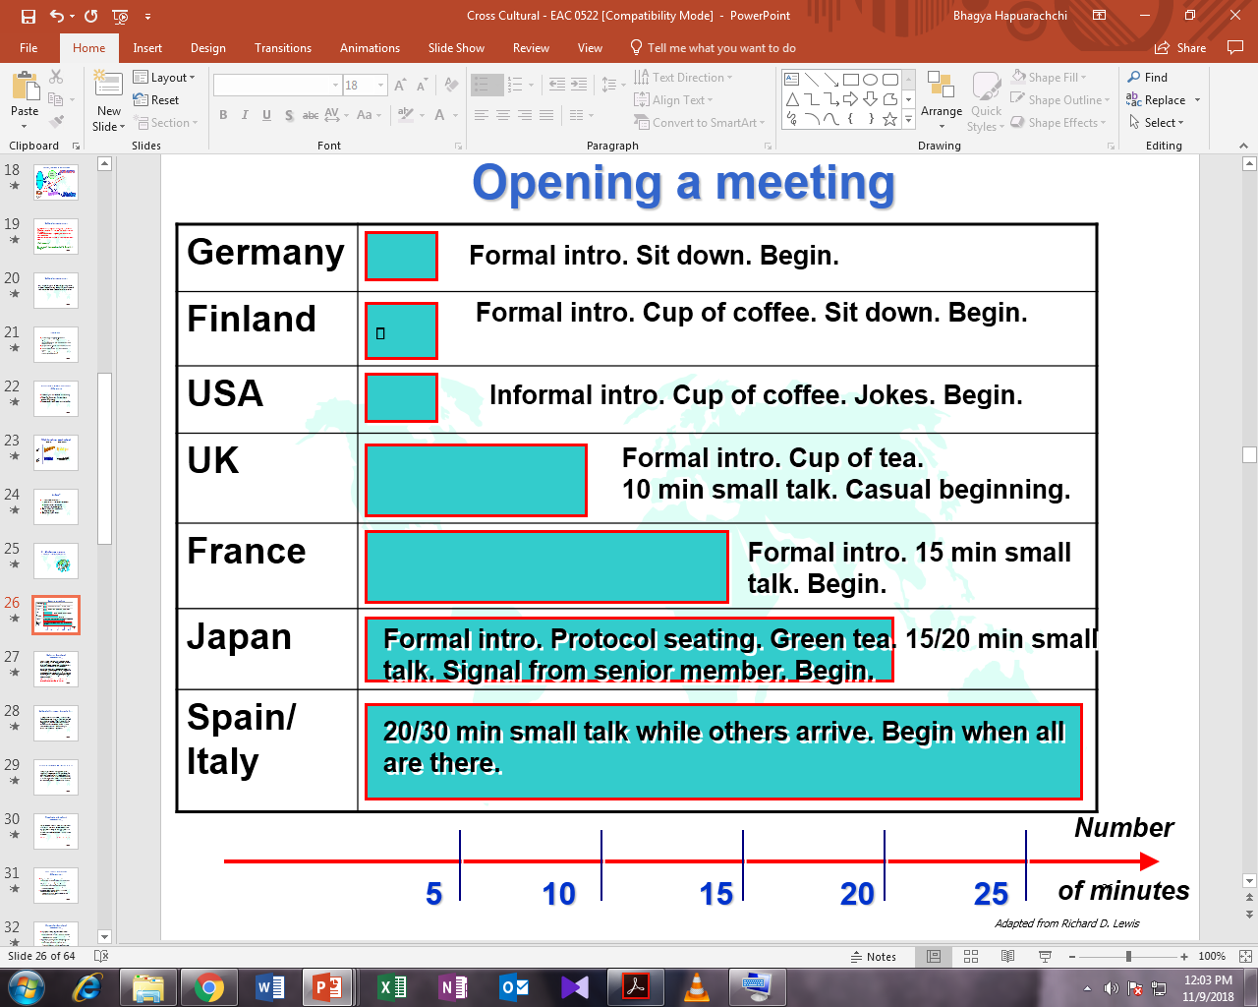

Slide 23
Cultural Differences
https://www.youtube.com/watch?v=0W9iLrfyq20
https://www.youtube.com/watch?v=zQvqDv4vbEg
https://www.youtube.com/watch?v=IwBPfbEeynw

Slide 24
Communicating Across Cultures
Speak clearly and more slowly than usual
Pronounce your words clearly and enunciate carefully
Use the simplest and most common words in most cases
Avoid slang and colloquial expressions
Use visuals
Confirm your spoken communications by memos, e-mails, letters, faxes

Slide 25
Hofstede’s Dimensions of Cultural Variability
Individualism and collectivism - I vs WE
Uncertainty avoidance - What’s different is dangerous vs What’s different is curious
Power distance
Masculinity–femininity
Long- Versus Short-Term Orientation
Indulgence Versus Restraint (IVR)

Slide 26
Cultural Variability
High context and low context cultures
In a high context (HC) culture, internal meaning is usually embedded deep in the information, so not everything is explicitly stated in writing or when spoken. In an HC culture, the listener is expected to be able to read “between the lines”, to understand the unsaid, thanks to his or her background knowledge.

Slide 27
Cultural Variability: High and Low Context
Hall (1976, 91) emphasised that “a high-context communication or message is one in which most of the information is either in the physical context or internalised in the person, while very little is in the coded, explicit., or transmitted part of the message”.
In a low context (LC) culture, meanings are explicitly stated through language.
People communicating usually expect explanations when something remains unclear.
https://www.youtube.com/watch?v=9oYfhTC9lIQ

Slide 28
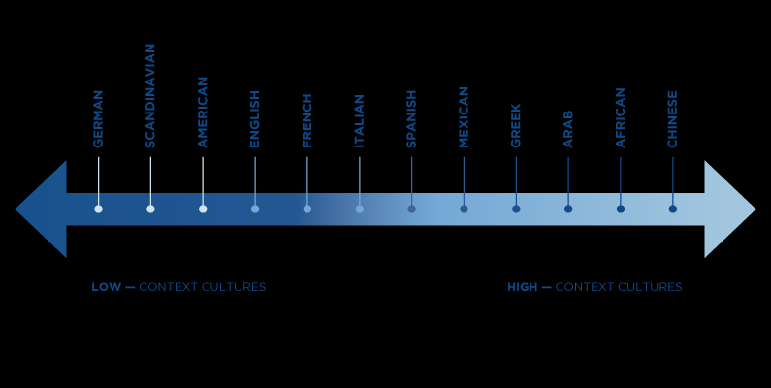

Slide 29
Discomfort and Cultural Differences
Why doesn’t he/she says yes or no?
In one culture, an indirect signal may signal indecisiveness, while in another culture it signals deference & respect.
Why he/she always staring at me?
In one culture staring can signal aggressiveness or intimidation, while in another culture direct eye contact shows attention & esteem.
Why does he/she have to be right in my face whenever he/she talks to me?
In one culture the range of personal space can be much smaller than in another culture.

Slide 30
Avoid Stereotypes
To better understand our own personal outlook we must ask ourselves if we have used any of these phrases:
“People from (country) are…”
“It has nothing to do with a cultural issue”
“It’s really hard to work with (nationality) people because….”
By saying our own generalizations of people from a country, race or religion, we actively create stereotypes. These are generally extremely negative, and restrict our ability to relate to any individuals outside our own culture.
The lack of knowledge of others’ customs, values, and habits leads to poor communication and a lack of sensitivity.
This causes negative reactions, and even worse, negative consequences.
People from other cultures work differently, it does not mean they are wrong—they still may accomplish the desired results.

Slide 31
Discussion
As a leader of of cross-cultural team, Ms. C. is having difficulties managing Mr. H., one of the foreign member of the team. He promised to compile a report by the deadline she set, but he didn’t. When she talks to him about it, he won't look her in the eyes.
What’s happening? Can you identify the two cultures that Ms. C. and Mr. H. belong to?

Slide 32
Activity
Examine your own cultural conditioning.

Slide 33
Personality and Communication

Slide 34
What is Personality?
“Personality type refers to the psychological classification of different types of individuals” (Emanuel 2003: 4).
W. Soldz and G. Vaillant say that the personality of a person is likely to be unchanging throughout life.
Personality is shaped not only by genetics but also by learning.
Carl Jung: two opposite styles

Slide 35
What is Personality?
People have preferences in how they think and feel. These determine how we work, play, and engage.

Slide 36
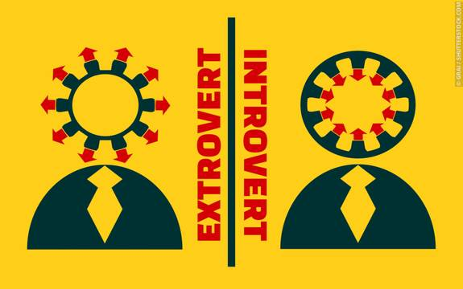

Slide 37
Florence Littauer (1983)
the Popular Sanguine: The Popular Sanguine is the born entertainer who likes parties, people and fun.
the Perfect Melancholy: The Perfect Melancholy is a born thinker who likes solitude and silence.
the Powerful Choleric: The Powerful Choleric is a born leader who likes action and progress, loves work, and wants to direct and motivate other people.
the Peaceful Phlegmatic: The Peaceful Phlegmatic is a born follower who loves to rest and relax and who thrives on harmony.

Slide 38
MBTI Personality Types
The Myers-Briggs Type Indicator® (MBTI®) assessment is a short, self report questionnaire used to measure and describe people’s preferences for how they like to focus attention, get information, make decisions and orient their lives.

Slide 39
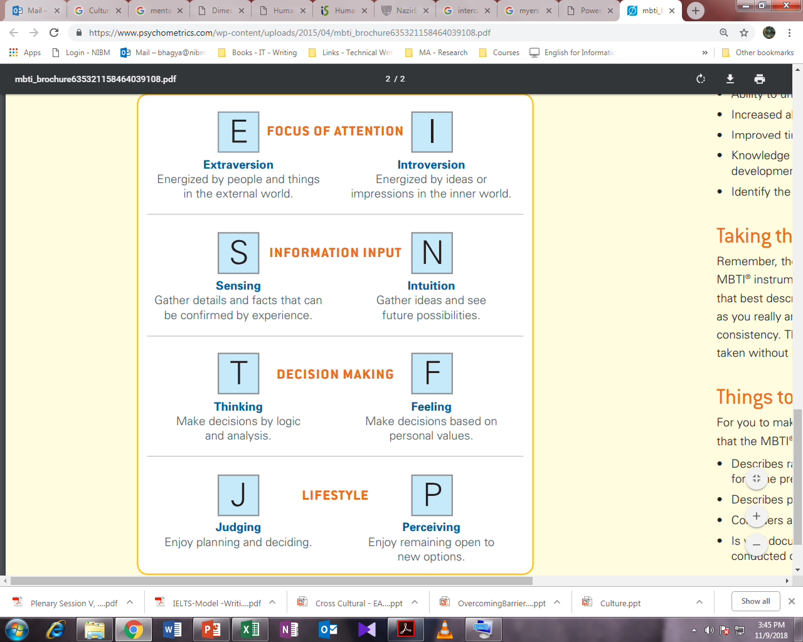

Slide 40
Personality
Although there are no right or wrong styles in communication, miscommunication can arise, and incorrect impressions can be formed when there is a mismatch in speaking styles.

Slide 41
Personality and Communication
It is the widely held notion that a person’s communication style is a natural extension and expression of their personality type and vice versa.
D. Loffredo and S. Opt. (2001) found that individuals who preferred extroversion, intuition and thinking had a greater tendency to be argumentative than those who preferred introversion, sensing and feeling.

Slide 42
MBTI Personality Types
Introverts think through ideas and problems before sharing them, whereas extraverts are often likely to talk in order to think.
Extraverts prefer to act rather than reflect, and find Introverts too slow in thinking through decisions, whereas Introverts believe Extraverts act prematurely.

Slide 43
MBTI Personality Types
Introverts communicating with Extraverts should:
1. Focus on actions to be taken
2. Focus on results
3. Communicate verbally with enthusiasm
4. Emphasize action over deliberation
Extraverts communicating with Introverts should:
1. Communicate a well-thought-through idea or plan
2. Build in time for Introverts to reflect before deciding
3. Communicate in written form rather than orally
4. Allow airtime for Introverts who wait for silence to speak

Slide 44
MBTI Personality Types
Sensors prefer facts to ideas, view obstacles as problems to solve rather as conundrums to explore, prefer “tried-and-true” solutions rather than new ones, and prefer action to conception of ideas.
Intuitives prefer new ideas and options to predictable solutions, favor innovation over practicality, and enjoy visioning and theorizing more than implementing.

Slide 45
MBTI Personality Types
Sensors communicating with Intuitives should:
1. Start with an overarching description of the issue or challenge rather than the relevant details
2. Allow room for creative exploration before moving to facts
3. Describe the overall goal and strategies before moving to tactics
4. Explain the desired outcomes and related challenges of a project
Intuitives communicating with Sensors should:
Clearly identify the problem they are trying to solve
2. Share relevant facts and details
3. Reduce risk factors or required changes
4. Describe successful applications of the desired strategies

Slide 46
MBTI Personality Types
Thinkers make decisions from an objective viewpoint, thoroughly analyzing the relevant issues. They tend to question ideas and solutions before accepting them.
Feelers focus more on values and people than on the task itself. Since interpersonal harmony is a central value for Feelers, they will focus on commonalities before discussing differences that require negotiation.

Slide 47
MBTI Personality Types
Thinkers communicating with Feelers should:
1. Be descriptive rather than judgmental
2. Use empathy by imagining the other’s perspective
3. Start with a concern for what is important to people
4. Consider a decision’s impact on the people who carry it out
5. Start with the positives rather than the negatives
Feelers communicating with Thinkers should:
1. Discuss the costs and benefits of the issues
2. Identify the issue clearly, the principles involved, and potential solutions, as well as their strengths and weaknesses
3. Take a stand and make their case succinctly
4. Be willing to engage in debate without taking it personally

Slide 48
MBTI Personality Types
Judgers prefer closure and organization to looseness and spontaneity; relax after completing their work (which means not a lot of relaxing!), and use lists and calendars to manage their time.
Perceivers value the management of time far less and prefer room to be spontaneous and change direction. They enjoy brainstorming and exploring new possibilities far more than decision-making itself.

Slide 49
MBTI Personality Types
Judgers communicating with Perceivers should:
1. Allow Perceivers flexibility around “how” they meet their goals
2. Allow sufficient time for brainstorming
3. Realize there are often far more ”right” solutions than their own
4. Consider multiple options before pressing for closure
5. Understand that over-directing Perceivers will lead to their resistance
Perceivers communicating with Judgers should:
1. Understand that frequent or last-minute changes adversely affect Judgers
2. Take Judgers’ deadlines seriously and “to the minute”
3. Balance brainstorming with analysis and decision-making
4. Reopen decisions only when new data significantly impacts the decision
5. Take a clear stand

Slide 50
Attitudes
Extraverts - action oriented
Introverts - thought oriented.
Extraverts seek breadth of knowledge and influence
Introverts seek depth of knowledge and influence
Extraverts often prefer more frequent interaction
Introverts prefer more substantial interaction.
Extraverts get their energy from spending time with people
Introverts get their energy from spending time alone.

Slide 51
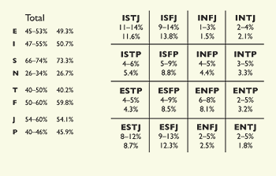

Slide 52
https://www.16personalities.com/

